Slide 1
Gentoo Linux
Installation Guide

Slide 2
Features of Gentoo Linux Distributions
Why Gentoo[link]
OS Type: Linux
Based on: Independent
Origin: USA
Architecture: i486, i586, i686, x86_64, alpha, arm, hppa, ia64, mips, powerpc, ppc64, sparc64
Desktop: AfterStep, Awesome, Blackbox, Enlightenment, Fluxbox, GNOME, IceWM, KDEPlasma, LXDE, MATE, Openbox, WMaker, Xfce
Category: Desktop, Server, Source-based
Status: Active
Gentoo Linux is a versatile and fast, completely free Linux distribution geared towards developers and network professionals.
Unlike other distros, Gentoo Linux has an advanced package management system called Portage. Portage is a true ports system in the tradition of BSD ports, but is Python-based and sports a number of advanced features including dependencies, fine-grained package management, "fake" (OpenBSD-style) installs, safe unmerging, system profiles, virtual packages, config file management, and more.

Slide 3
Boot using minimal live CD
Download minimal live CD: https://www.gentoo.org/downloads/
=> http://distfiles.gentoo.org/releases/amd64/autobuilds/20191002T214502Z/install-amd64-minimal-20191002T214502Z.iso
VMware/VirtualBox Preparation
RAM => 2048mb
HDD => VDI, dynamically allocated, 256gb
Choose the right language (fr, us)

Slide 4
Add Partitions to Hard Disk
Using fdisk to partition the disk
Command Lines
# fdisk /dev/sda
Goals 3 primary partitions
/dev/sda1 /boot 128M bootable, contain the grub boot manager, kernel, decryption software(cryptsetup)
/dev/sda2 swap(2G)
/dev/sda3 encrypted

Slide 5
Two ways of sorting the partitioning information on a drive
MBR vs. GPT
MBR(Master Boot Record)
Special boot sector located at the beginning of a drive
The sector contains a boot loader for the installed OS and information of the drive’s logical partitions.
The boot loader is a small bit of code that generally loads the larger boot loader from another partition on a drive
For example,. If you have Windows installed, the initial bits of the Windows boot loader reside here—that’s why you may have to repair your MBR if it’s overwritten and Windows won’t start. If you have Linux installed, the GRUB boot loader will typically be located in the MBR.
GPT(GUID Partition Table)
GPT stands for GUID Partition Table. It’s a new standard that’s gradually replacing MBR. It’s associated with UEFI
GPT, in turn, replaces the clunky old MBR partitioning system with something more modern. It’s called GUID Partition Table because every partition on your drive has a “globally unique identifier,” or GUID—a random string so long that every GPT partition on earth likely has its own unique identifier.
GPT stores multiple copies of this data across the disk, so it’s much more robust and can recover if the data is corrupted

Slide 6
Knowledge Tips:
Partitions Types
BIOS boot/ Boot partition sda1
#mkfs.ext2 /dev/sda1
Swap partition sda2
#mkswap /dev/sda2
#swapon /dev/sda2
In it’s simplest sense, the SWAP partition acts as an overflow to your (RAM) memory. If your memory is filled up completely, any additional applications will be run off of the SWAP partition rather than memory.
Advantages:
Provides overflow space when your memory fills up completely
Can move rarely-needed items away from your high-speed memory
Allows you to hibernate
Disadvantages:
Takes up space on your hard drive as SWAP partitions do not resize dynamically
Can increase wear and tear to your hard drive
Does not necessarily improve performance (see below)
Encrypted root partition sda3 root partition sda3
Encrypt the block device and designate a passphrase, by using the following command:
#cryptsetup luksFormat /dev/sda3
Unlock the encrypted volume and assign it a logical volume, as follows:
#cryptsetup luksOpen /dev/sda3/root
Create a file system in the decrypted volume, using the following command:
#mkfs.ext4 /dev/mapper/root
As shown in Figure 1, the partition has been encrypted and opened and, finally, a file system is associated with the partition.
Create a mount point for the file system, mount it, and then access its contents as follows:
#mkdir /mnt/gentoo
#mount /dev/mapper/ root /mnt/gentoo
We can verify the mounted partition using the df -h command
#cd /mnt/gentoo

Slide 7
Creating file systems to ext2 ext4
#fdisk
ext4
Initially created as a fork of ext3, ext4 brings new features, performance improvements, and removal of size limits with moderate changes to the on-disk format. It can span volumes up to 1 EB and with maximum file size of 16TB. Instead of the classic ext2/3 bitmap block allocation ext4 uses extents, which improve large file performance and reduce fragmentation. Ext4 also provides more sophisticated block allocation algorithms (delayed allocation and multiblock allocation) giving the filesystem driver more ways to optimize the layout of data on the disk. Ext4 is the recommended all-purpose all-platform filesystem.
ext2
This is the tried and true Linux filesystem but doesn't have metadata journaling, which means that routine ext2 filesystem checks at startup time can be quite time-consuming. There is now quite a selection of newer-generation journaled filesystems that can be checked for consistency very quickly and are thus generally preferred over their non-journaled counterparts. Journaled filesystems prevent long delays when the system is booted and the filesystem happens to be in an inconsistent state.
Luks Linux Unified Key Setup
LUKS is the standard for Linux hard disk encryption. By providing a standard on-disk-format, it does not only facilitate compatibility among distributions, but also provides secure management of multiple user passwords. In contrast to existing solution, LUKS stores all setup necessary setup information in the partition header, enabling the user to transport or migrate his data seamlessly.

Slide 8
Activating the swap partition
Mounting the root partation
Command Lines
#mkfs.ext2 /dev/sda1
#mkswap /dev/sda2
#swapon /dev/sda2
#cryptsetup luksFormat /dev/sda3
#cryptsetup luksOpen /dev/sda3/root
#mkfs.ext4 /dev/mapper/root
#mount /dev/mapper/root /mnt/gentoo
#cd /mnt/gentoo

Slide 9
Device mapper
The device mapper is a framework provided by the Linux kernel for mapping physical block devices onto higher-level virtual block devices. It forms the foundation of the logical volume manager (LVM), software RAIDs and dm-crypt disk encryption, and offers additional features such as file system snapshots.
Device mapper works by passing data from a virtual block device, which is provided by the device mapper itself, to another block device. Data can be also modified in transition, which is performed, for example, in the case of device mapper providing disk encryption or simulation of unreliable hardware behavior.
cryptsetup – utility used to conveniently setup disk encryption based on dm-crypt
dm-crypt/LUKS – mapping target that provides volume encryption

Slide 10
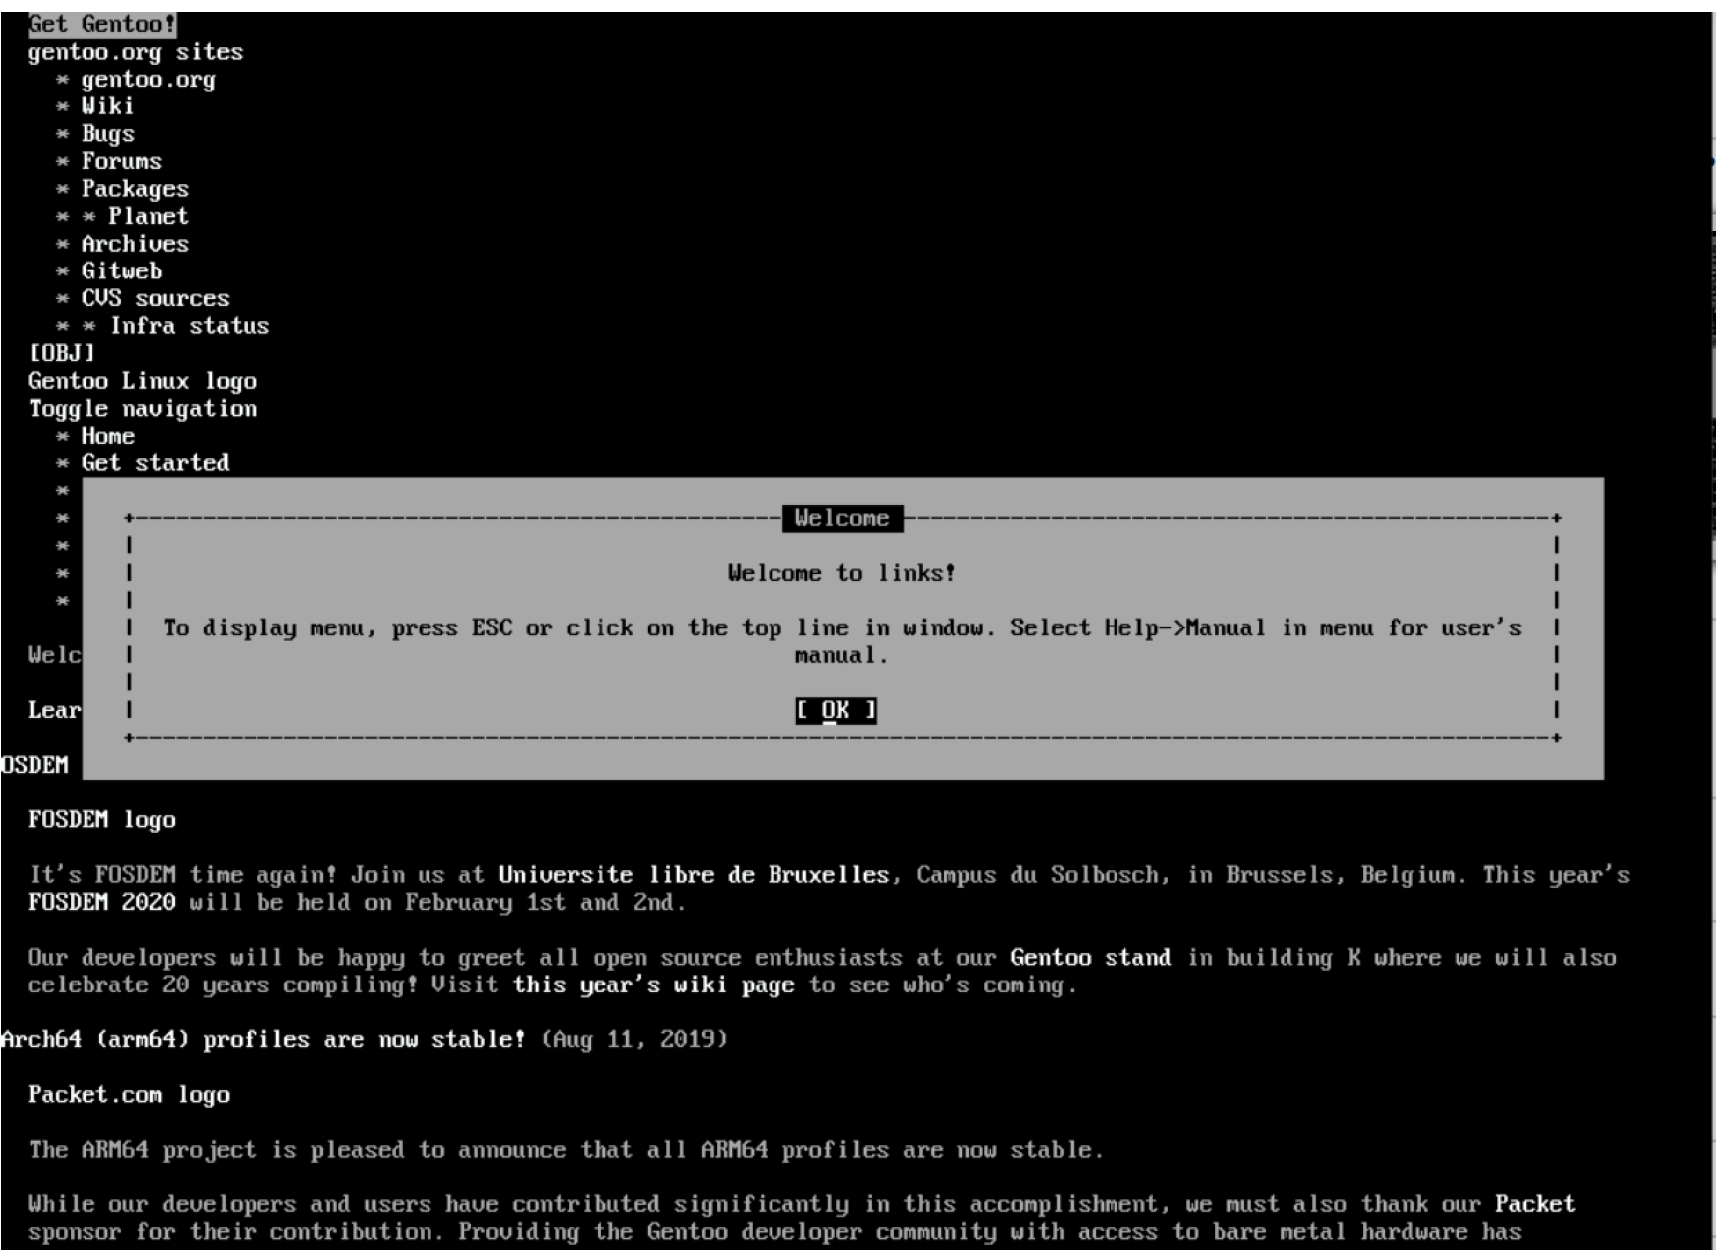
#cd /mnt/gentoo/
#links https://gentoo.org/downloads/
# tar xpvf stage3*.tar.xz
Installing the Gentoo installation files
Download and unzip Stage3*.tar.xz

Slide 11
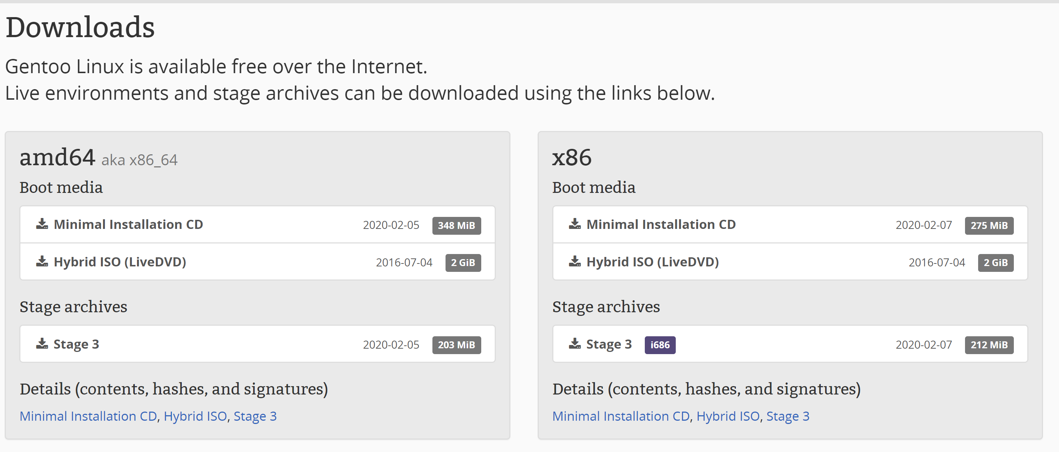
Choosing a stage tarball according to
64-bit<amd64> /32-bit<x86> architecture

Slide 12
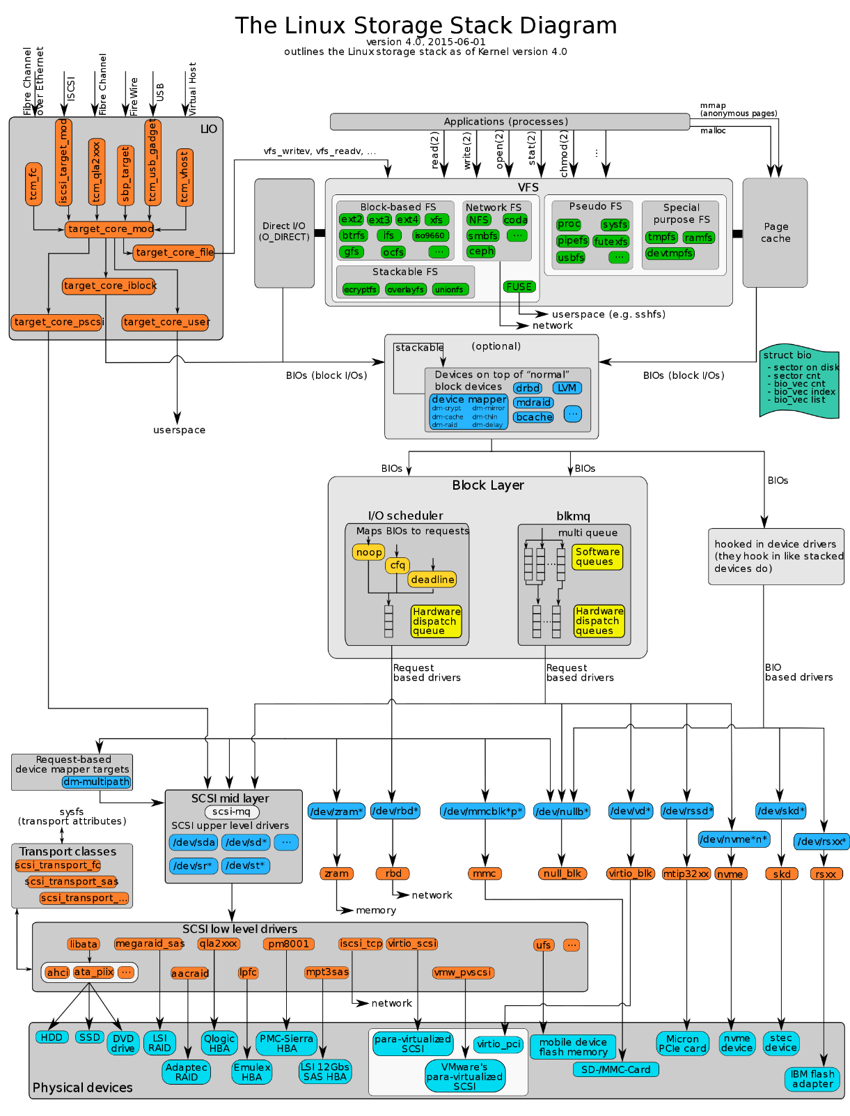
Knowledge Tips:
Logical Volume Manager(Linux)
/dev/mapper
Applications (like LVM2 and Enterprise Volume Management System (EVMS)) that need to create new mapped devices talk to the device mapper via the libdevmapper.so shared library, which in turn issues ioctls to the /dev/mapper/control device node.
Configuration of the device mapper can be also examined and configured interactively‍—‌or from shell scripts‍—‌by using the dmsetup utility

Slide 13
Open /mnt/gentoo/etc/portage/make.conf file and configure the system with your preferred optimization variables
#mkdir /mnt/gentoo/etc/portage/repos.conf
#cp /mnt/gentoo/usr/share/portage/config/repos.conf /mnt/gentoo/etc/portage/repos.conf/gentoo.conf
To optimize Gentoo, it is possible to set a couple of variables which impacts the behavior of Portage, Gentoo's officially supported package manager. All those variables can be set as environment variables (using export) but that isn't permanent. To keep the settings, Portage reads in the /etc/portage/make.conf file, a configuration file for Portage.
Configuring compile options

Slide 14
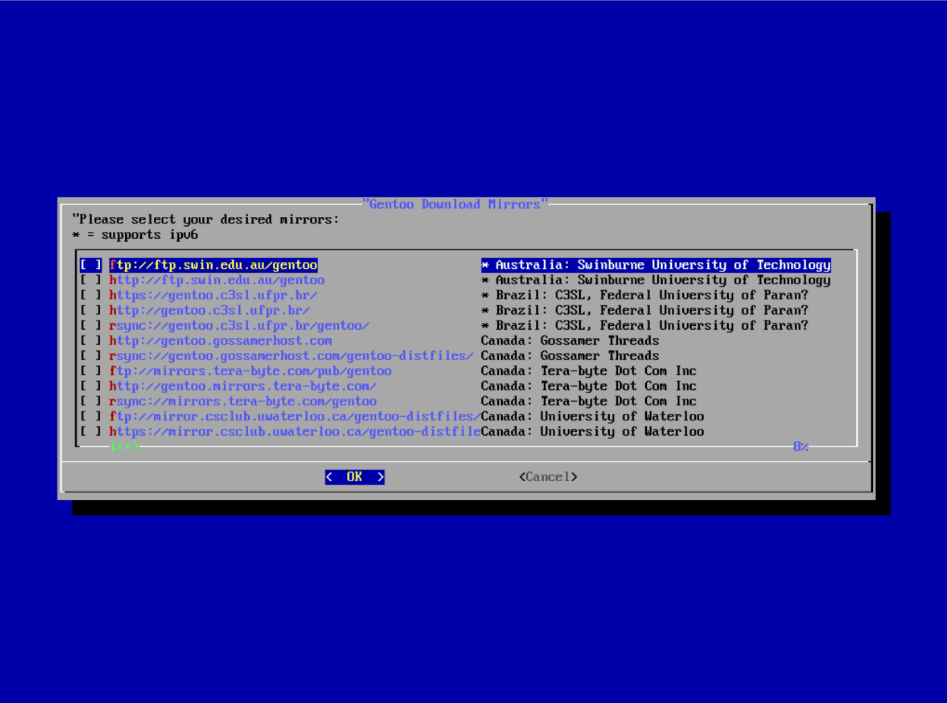
Optional:
Selecting mirrors

Slide 15
Prepare the System for Rooting
Mounting the necessary filesystems
CHROOT
CHROOT
Mount proc, dev filesystems
# mount --types proc /proc /mnt/gentoo/proc
# mount --rbind /sys /mnt/gentoo/sys
# mount --make-rslave /mnt/gentoo/sys
# mount --rbind /dev /mnt/gentoo/dev
# mount --make-rslave /mnt/gentoo/dev
Chrooting to the new environment:
# chroot /mnt/gentoo /bin/bash
# source /etc/profile
# export PS1="(chroot) ${PS1}“
mounting the boot partition
# mount /dev/sda1 /boot
Then updating your @world packages (all installed packages):
# emerge-webrsync –q
Setting the timezone: from /usr/share/zoneinfo we find our timezone to be Europe/Paris
# echo "Europe/Paris" > /etc/timezone
# emerge --config timezone-data

Slide 16
Purpose of chroot
Some common uses are:
Software Development and Product Verification.
Reducing Development Risk.
Running Deprecated Software.
Recovery and Filesystem Upgrades
Ringfencing Applications.
Chroot was first utilized in the development of Unix version 7 in 1979. It was later added to BSD on March 18, 1982. Computer programmers can use a chroot virtual environment to develop and test software programs, especially if doing so on a production system is too risky. They can also use a chroot virtual environment to run software programs that have compatibility issues with the computer's operating system. They can set up the software in the virtual environment, along with the supported libraries and files needed to run the software. Chroot has also been used by POSIX systems for their FTP servers, to isolate untrusted FTP clients.

Slide 17
#emerge in portage
Portage is the official package manager and distribution system for Gentoo. It functions as the heart of Gentoo-based operating systems. Portage includes many commands for repository and package management, the primary of which is the emerge command.
#emerge --sync
Sync the system in case it is a bit behind on the current Gentoo repository, update to the latest version
# emerge –sync
CONFIGURATION FILES
Portage has a special feature called "config file protection". The purpose of this feature is to prevent new package installs from clobbering existing configuration files. By default, config file protection is turned on for /etc and the KDE configuration dirs; more may be added in the future. When Portage installs a file into a protected directory tree like /etc, any existing files will not be overwritten. If a file of the same name already exists, Portage will change the name of the to-be-installed file from 'foo' to '._cfg0000_foo'. If '._cfg0000_foo' already exists, this name becomes '._cfg0001_foo', etc. In this way, existing files are not overwritten, allowing the administrator to manually merge the new config files and avoid any unexpected changes.
In addition to protecting overwritten files, Portage will not delete any files from a protected directory when a package is unmerged. While this may be a little bit untidy, it does prevent potentially valuable config files from being deleted, which is of paramount importance.
Protected directories are set using the CONFIG_PROTECT variable, normally defined in make.globals. Directory exceptions to the CONFIG_PROTECTed directories can be specified using the CONFIG_PROTECT_MASK variable. To find files that need to be updated in /etc, type find /etc -name '._cfg????_*'.
You can disable this feature by setting CONFIG_PROTECT="-*" in make.conf(5). Then, Portage will mercilessly auto-update your config files. Alternatively, you can leave Config File Protection on but tell Portage that it can overwrite files in certain specific /etc subdirectories. For example, if you wanted Portage to automatically update your rc scripts and your wget configuration, but didn't want any other changes made without your explicit approval, you'd add this to make.conf(5):
CONFIG_PROTECT_MASK=/etc/wget /etc/rc.d

Slide 18
/etc/portage/repos.conf
/etc/portage/repos.conf can be a file or directory which specifies the location and settings for the repositories used by the current system. It refers to the Gentoo repository and perhaps ebuild repositories used on a system.
# mkdir /mnt/gentoo/etc/portage/repos.conf
# cp /mnt/gentoo/usr/share/portage/config/repos.conf /mnt/gentoo/etc/portage/repos.conf/gentoo.conf

Slide 19
#make.conf
SYNOPSIS
/etc/make.conf and /etc/portage/make.conf DESCRIPTION
This file contains various variables that are used by Portage. The file has a newline-delimited list of <key>=<value> pairs (see the default file for examples) which are accessible from the environment of ebuilds. It supports simple shell-like expansion of the form var="${var}", the source keyword and variable substitution, but not some of the more advanced BASH features like arrays and special parameter expansions. For more details, see the Simple lexical analysis documentation: https://docs.python.org/3/library/shlex.html. Note that if you source files, they need to be in the same shlex syntax for portage to read them. If make.conf is a directory, then all the files in that directory will be sorted in ascending alphabetical order by file name and summed together as if it were a single file.
Portage will check the currently-defined environment variables first for any settings. If no environment settings are found, Portage then checks the make.conf files. Both /etc/make.conf and /etc/portage/make.conf are checked (if present), and settings from /etc/portage/make.conf will override settings from /etc/make.conf. If no setting is found in the make.conf files, Portage checks make.globals. If no setting is found there, the profile's default setting is grabbed from /etc/portage/make.profile/make.defaults. Please note that all user settings should be made in the environment or in the make.conf files, which are intended to be customized by the user.
Exceptions are incremental variables such as USE, CONFIG_PROTECT*, and ACCEPT_KEYWORDS. Incremental variables are propagated down from make.defaults to make.globals to make.conf to the environment settings. Clearing these variables requires a clear-all as in: export USE="-*"
In order to create per-package environment settings, refer to package.env in portage(5).

Slide 20
USE flag in gentoo
To help users in deciding what to install/activate and what not, Gentoo wanted the user to specify his/her environment in an easy way. This forces the user into deciding what they really want and eases the process for Portage to make useful decisions.
# nano /etc/portage/make.conf
and add cryptsetup to the USE flags so it becomes a dependency of genkernel and gets installed to decrypt /dev/sda3 at boot:
USE="cryptsetup"
Precedence
Of course there is a certain precedence on what setting has priority over the USE setting. The precedence for the USE setting is, ordered by priority (first has lowest priority):
Default USE setting declared in the make.defaults files part of your profile
User-defined USE setting in /etc/portage/make.conf
User-defined USE setting in /etc/portage/package.use
User-defined USE setting as environment variable
To view the final USE setting as seen by Portage, run emerge --info. This will list all relevant variables (including the USE variable) with their current definition as known to Portage.

Slide 21
GRUB install and configuration on the boot loader
Install GRUB using grub-install command for boot loader. This command to copy relevant /boot/grub/
#grub-install /dev/sda
If everything goes well then the output of the command will be as below:
#grub-install /dev/sda Installation finished. No error reported.
Following command for updating the GRUB’s configuration file which means when the new Kernel installed, the GRUB must be reconfigured. #grub-mkconfig -o /boot/grub/grub.cfg

Slide 22
Install DHCP which will enable for handling IPv4 and IPv6 configuration. The DHCP will be installed by following command. # emerge dhcpcd
To verify network IP address and name, we can use “ifconfig” in Linux as below: #ifconfig
DHCP configuration #nano /etc/conf.d/net >> config_enp0s3="dhcp“
The service script will be created by using symlink and the configuration will be done in “etc/conf.d/net” under path of “/etc/init.d” # cd /etc/init.d #ln -s net.lo net.enp0s3
Running the rc-update is the final step in the configuration process. Add each interface to the system's init process so they are automatically started when the system boots. Normally interfaces are added to the default run level: #rc-update add net.enp0s3 default
Install DHCP client
Create symlink
Enable at Boot

Slide 23
Installing system tools:
System logging & Cron daemon
To set the hostname to selected host as below: #nano /etc/conf.d/hostname >> hostname=“hostname”
To keyboard configuration will be done with below command and edit it to select right keyboard # nano /etc/conf.d/keymaps keymap=“us”
Install the logging tool and add it to the default run level using rc-update to load in the boot list as below #emerge cronie sysklogd # rc-update add cronie default # rc-update add sysklogd default

Slide 24
Set password for root and unmount
Setup password for root #passwd root
Once you set the root password, you have to “exit” from chroot
Unmount the all the mounted devices # umount /mnt/gentoo/boot # umount /mnt/gentoo/proc # umount -R /mnt/gentoo/dev # umount -R /mnt/gentoo/sys # umount /mnt/gentoo
Then reboot the system
#reboot

Slide 25
Customize the Portage environment
Create a user and named as John #useradd -m -G users,wheel,audio -s /bin/bash john
Set the password for user “John” #passwd john
The CFLAGS and CXXFLAGS variables define the build and compile flags that will be used for all package deployments. It is used to customize the Portage environment on a global level. #nano e/etc/portage/make.conf
Inside the script: USE="cryptsetup -cups -ldap -bluetooth -firmware -sound -alsa"
User creation
CFLAGS and CXXFLAGS

Slide 26
Make an own rebuild environment dependencies to your new profile. # emerge --update --deep --newuse @world
Edit .xinitrc file and add the command on the script to define which application should run when startx is run. # nano .xinitrc exec i3
Ranger is a console file manager that gives you greater flexibility and a good overview of your files without having to leave your console. By following command we can install this package. #emerge ranger

Slide 27
References:
Official Gentoo Installation Book [REF]
How to install Gentoo with LUKS LVM and systemd[REF]

